Slide 1


MySQL Introduction
How do RDBMS work?
SoftUni Team
Technical Trainers
Software University
http://softuni.bg

Slide 2
Table of Contents
Introduction
Big Picture
Databases
Data Management
Database Engine & Storage
Data Types, Database Modeling
Introduction to SQL
SELECT, INSERT, UPDATE, DELETE

Slide 3
Have a Question?
sli.do
#php-web

Slide 4

Introduction
4

Slide 5
Big Picture
HTTP
Server
File
TCP/Socket
Internet
Browser
Web Server
PHP
DB
DB Client

Slide 6

Database
6

Slide 7

Data Management
When do we need a database?
7

Slide 8
Storage vs. Management
SALES RECEIPT
Date | 07/16/2016
Order# | [00315]
Customer | David Rivers
Product | Oil Pump
S/N | OP147-0623
Unit Price | 69.90
Quantity | 1
Total | 69.90
00315 – 07/16/2016
David Rivers
Oil Pump (OP147-0623)
1 x 69.90

Slide 9
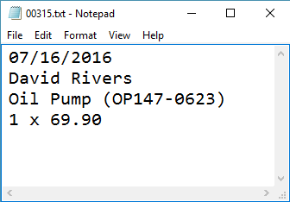
Storage vs Management
Order# | Date | Customer | Product | S/N | Unit Price | Qty | Total
00315 | 07/16/2016 | David Rivers | Oil Pump | OP147-0623 | 69.90 | 1 | 69.90

Slide 10

Storage vs. Management (2)
Storing data is not the primary reason to use a database
Flat storage eventually runs into issues with:
Size
Ease of updating
Accuracy
Security
Redundancy
Importance

Slide 11


Database Engine
11

Slide 12





Database Engine Flow
SQL Server uses the Client-Server Model
Clients
Engine
Database
Query
Access
Data
Data

Slide 13
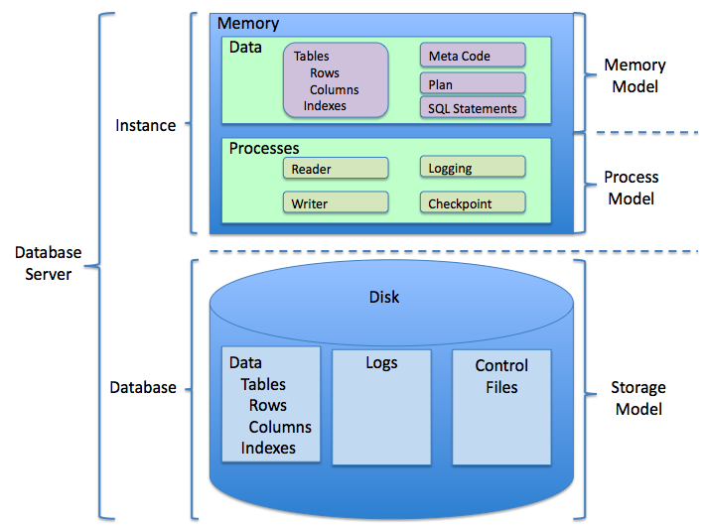
Database Engine Flow (2)

Slide 14
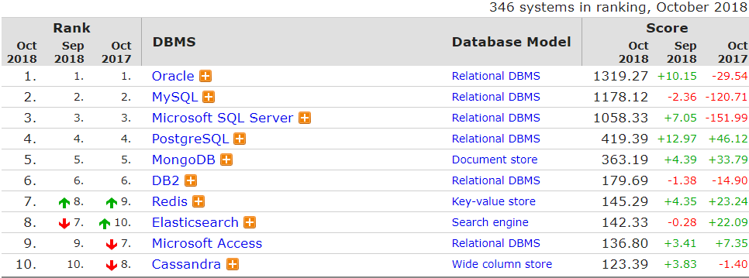
Top Database Engines
Source: http://db-engines.com/en/ranking

Slide 15

Database Types
Relational database (RDBMS)
Document-oriented database
Key-value database
TimeSeries
Triplestore
And many more…
K -> V

Slide 16
Databases and RDBMS
A database is an organized collection of information
It imposes rules on the contained data
A Relational Data Base Management System provides tools to manage the database
It parses requests from the user and takes the appropriate action
The user doesn’t have direct access to the stored data

Slide 17


MySQL / MariaDB
17

Slide 18






Download Clients & Servers
Download XAMPP or Official MySQL Server or MariaDB Server
Download HeidiSQL, DataGrip or something else..

Slide 19
MySQL Server Architecture
Logical Storage
Instance
Database/Schema
Table
Physical Storage
Data files and Log files
Data pages
Instance
Database
Database
Table
Table
Table
View
View
Database
Procedure
Data
Logs
☰
☰
☰
☰
☰
☰
☰
☰

Slide 20
Database Table Elements
The table is the main building block of any databasе
Each row is called a record or entity
Columns (fields) define the type of data they contain
Column
CustomerID | FirstName | Birthdate | CityID
1 | Brigitte | 03/12/1975 | 101
2 | August | 27/05/1968 | 102
3 | Benjamin | 15/10/1988 | 103
4 | Denis | 07/01/1993 | 104
Cell
Row
Notes:
The table is the main unit of data storage. It has rows, columns and cells. Cells contain stored data. Each column has a data type. Types can be VARCHAR(String), INT, DATE etc.

Slide 21
integer
char
text
float
Data Types in MySQL Server
21

Slide 22


Basic Data Types in MySQL
Numeric
integer - different sizes
float, double, decimal - representing real numbers
Strings
char(size) - fixed size string
varchar(size) - variable size string
text, tinytext, mediumtext, longtext - text data block

Slide 23
Basic Data Types in MySQL (2)
Binary data
binary(size) - fixed binary byte strings
varbinary(size) - variable size binary byte strings
Date and time
date - range is '1000-01-01 to 9999-12-31'
datetime - range is '1000-01-01 00:00:00' to '9999-12-31 23:59:59'
timestamp - range of '1970-01-01 00:00:01' UTC to '2038-01-19 03:14:07' UTC

Slide 24
Structured Query Language
To communicate with the Engine we use SQL
Declarative language
Logically divided in four sections
Data Definition – describe the structure of our data
Data Manipulation – store and retrieve data
Data Control – define who can access the data
Transaction Control – bundle operations and allow rollback

Slide 25


Database Modeling
Data Definition using HeidiSQL
25

Slide 26

Working with HeidiSQL
HeidiSQL is a tool that helps us when working with the database and its objects
Enables us:
To create a new database
To create objects in the database (tables, stored procedures, relationships and others)
To change the properties of objects
To enter records into the tables

Slide 27
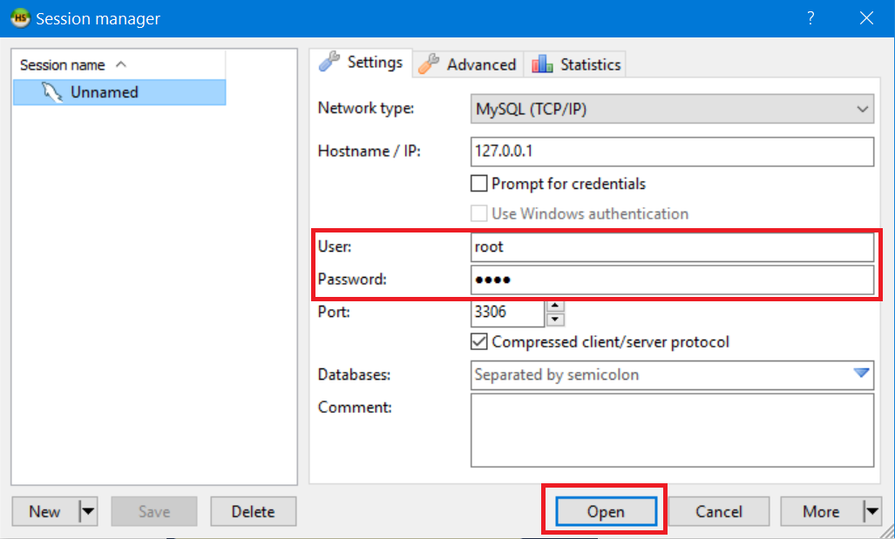
Make New Connection
Connect to MySQL Server with user root and the password you set up

Slide 28
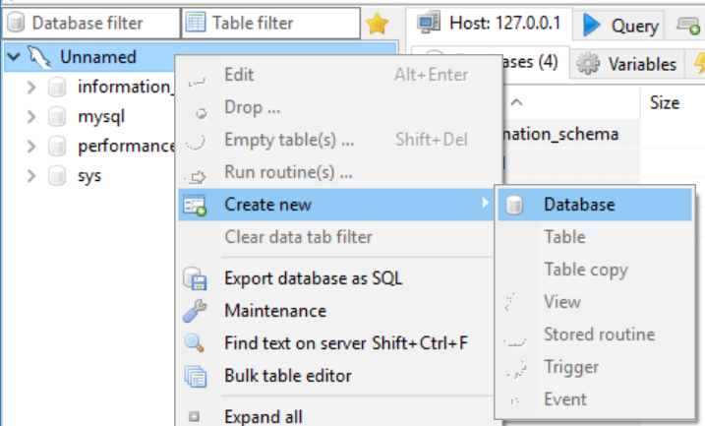
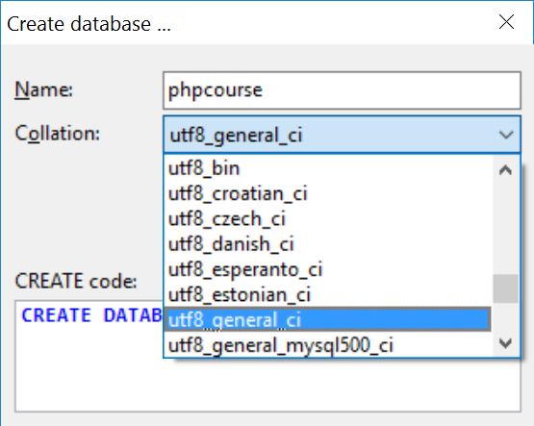
Creating a New Database
Select Create new -> Database from the context menu
Encoding

Slide 29
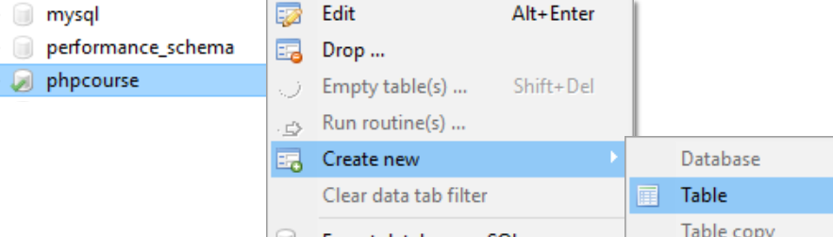
Creating Tables
From the context menu under Create new -> Table inside the desired database

Slide 30
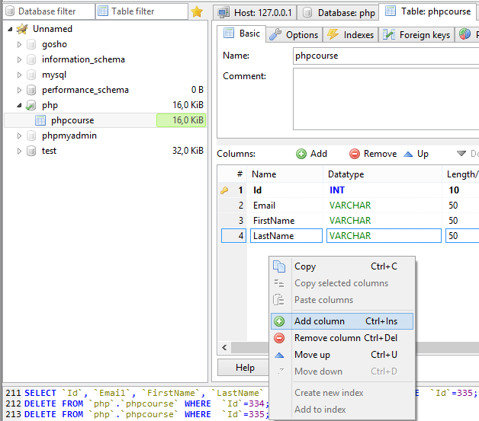
Creating Tables (2)
To add a field use Add column

Slide 31
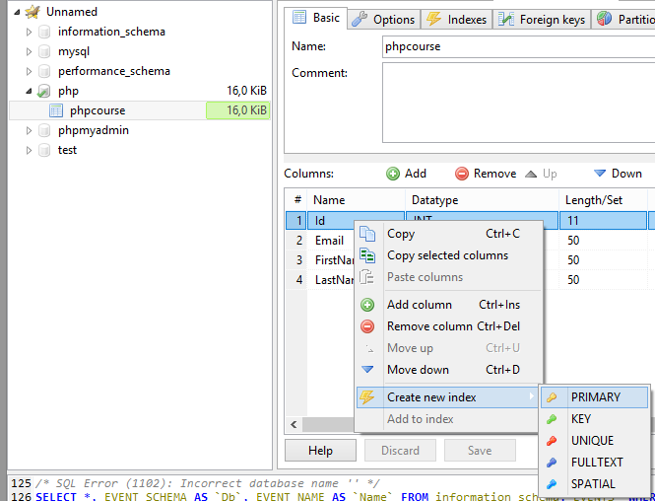
Creating Tables (3)
A Primary Key is used to uniquely identify and index records
Click PRIMARY from the context menu of the desired field

Slide 32
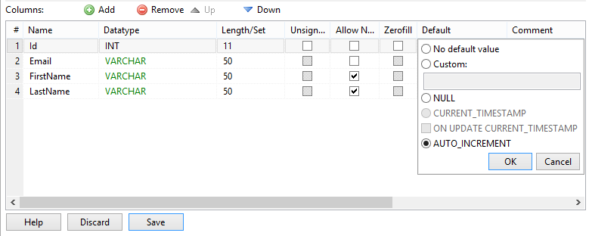
Field Defaults
You can set a default value for every field
No default value makes the field mandatory on row insert

Slide 33
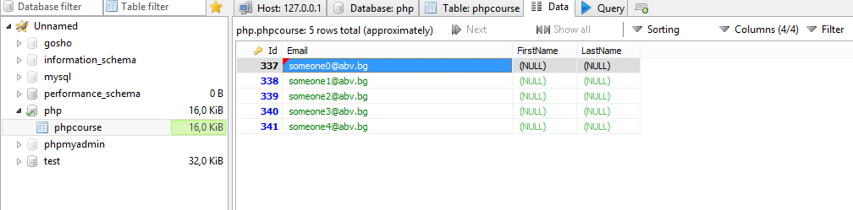
Manipulate Data
For all kinds of data manipulations select the Data tab

Slide 34
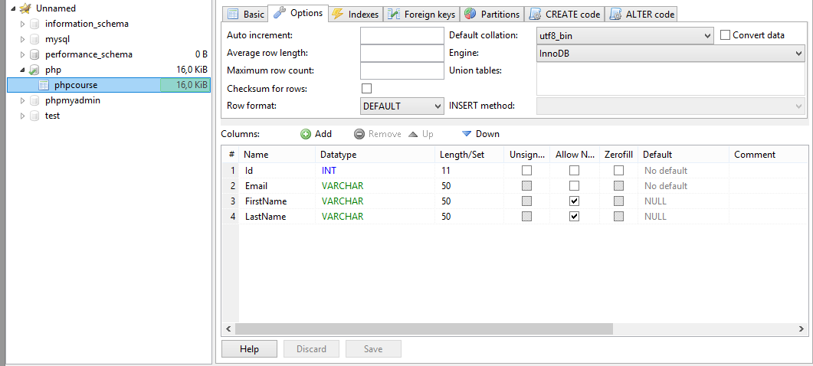
Altering Tables
You can change the properties of a table after its creation

Slide 35
SQL
SQL Introduction
35

Slide 36
What is SQL?
Structured Query Language (SQL) – en.wikipedia.org/wiki/SQL
Declarative language for working with relational data
Meant to be as close to regular English as possible
Supports definition, manipulation and access control of records
MySQL Dialect
Supports own control statements (if statements, loops etc..)
Designed for writing logic inside the database

Slide 37
SQL – Few Examples
SELECT FirstName, LastName, JobTitle FROM Employees
SELECT * FROM Projects WHERE StartDate = '1/1/2006'
INSERT INTO Projects(Name, StartDate)
VALUES('Introduction to MySQL', '1/1/2006')
UPDATE Projects
SET EndDate = '8/31/2006'
WHERE StartDate = '1/1/2006'
DELETE FROM Projects
WHERE StartDate = '1/1/2006'

Slide 38
SQL Queries
We can communicate with the database engine using SQL
Queries provide greater control and flexibility
To create a database using SQL:
SQL keywords are traditionally capitalized
Database name
CREATE DATABASE People

Slide 39
Table Creation in SQL
Table name
CREATE TABLE Employees
(
Id int NOT NULL,
Email varchar(50) NOT NULL,
FirstName varchar(50),
LastName varchar(50)
)
Custom properties
Column name
Data type

Slide 40
Retrieve Records in SQL
Selecting all columns from the "Departments" table
Selecting specific columns
SELECT * FROM Departments
DepartmentID | Name | ManagerID
1 | Engineering | 12
2 | Tool design | 4
3 | Sales | 273
… | … | …
List of columns
(* for everything)
Table name
DepartmentID | Name
1 | Engineering
2 | Tool design
3 | Sales
… | …
SELECT DepartmentId, Name
FROM Departments
Notes:
Selecting All Columns of All Rows
You can display all columns of data in a table by following the SELECT keyword with an asterisk (*). In the example on the slide, the department table contains five columns: DepartmentID, Name, GroupName, ModifiedDate and rowguid. The table contains 16 rows, one for each department.
You can also display all columns in the table by listing all the columns after the SELECT keyword. For example, the following SQL statement, like the example on the slide, displays all columns and all rows of the Departments table:
SELECT DepartmentID, Name, GroupName, ModifiedDate, rowguid
FROM department;
Selecting Specific Columns of All Rows
You can use the SELECT statement to display specific columns of the table by specifying the column names, separated by commas. The example on the slide displays all the department numbers and location numbers from the Departments table.
In the SELECT clause, specify the columns that you want, in the order in which you want them to appear in the output. For example, to display location before department number going from left to right, you use the following statement:
SELECT DepartmentID, Name
FROM Departments

Slide 41
Column Aliases
Aliases rename a table or a column heading
You can shorten fields or clarify abbreviations
SELECT EmployeeID AS ID, FirstName, LastName
FROM Employees
Display name
ID | FirstName | LastName
1 | Guy | Gilbert
2 | Kevin | Brown
… | … | …
SELECT c.Duration,
c.ACG AS 'Access Control Gateway'
FROM Calls AS c

Slide 42
Concatenation Operator
You can concatenate column names or strings using CONCAT
String literals are enclosed in single or double quotes
Table and column names containing special symbols use '' or ''
SELECT CONCAT(FirstName, ' ', LastName) AS `Full Name`,
EmployeeID AS `No.`
FROM Employees
Full Name | No.
Guy Gilbert | 1
Kevin Brown | 2
… | …

Slide 43
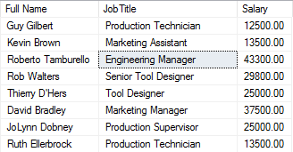
Problem: Employee Summary
Find information about all employees, listing their full name, job title and salary
Use concatenation to display first and last names as one field
Note: Create and Query SoftUni database

Slide 44
Solution: Employee Summary
Concatenation
SELECT CONCAT(FirstName, ' ', LastName)
AS `Full Name`,
JobTitle,
Salary
FROM Employees
Column alias

Slide 45
Filtering the Selected Rows
Use DISTINCT to eliminate duplicate results
You can filter rows by specific conditions using the WHERE clause
Other logical operators can be used for greater control
SELECT DISTINCT DepartmentID
FROM Employees
SELECT LastName, DepartmentID
FROM Employees
WHERE DepartmentID = 1
SELECT LastName, Salary FROM Employees
WHERE Salary <= 20000
Notes:
In the example, the SELECT statement retrieves the name and department number of all employees whose department is 1.

Slide 46
Other Comparison Conditions
Conditions ca be combined using NOT, OR, AND and brackets
Using BETWEEN operator to specify a range:
Using IN / NOT IN to specify a set of values:
SELECT LastName FROM Employees
WHERE NOT (ManagerID = 3 OR ManagerID = 4)
SELECT LastName, Salary FROM Employees
WHERE Salary BETWEEN 20000 AND 22000
SELECT FirstName, LastName, ManagerID FROM Employees
WHERE ManagerID IN (109, 3, 16)
Notes:
The BETWEEN Condition
You can display rows based on a range of values using the BETWEEN range condition. The range that you specify contains a lower limit and an upper limit.
The SELECT statement on the slide returns rows from the Employees table for any employee whose base rate is between 40 and 50.
Values specified with the BETWEEN condition are inclusive. You must specify the lower limit first.
The IN Condition
To test for values in a specified set of values, use the IN condition. The IN condition is also known as the membership condition.
The LIKE Condition
You may not always know the exact value to search for. You can select rows that match a character pattern by using the LIKE condition. The character pattern-matching operation is referred to as a wildcard search. Two symbols can be used to construct the search string.
Search conditions can contain either literal characters or numbers:
% denotes zero or many characters.
_ denotes one character.

Slide 47
Comparing with NULL
NULL is a special value that means missing value
Not the same as 0 or a blank space
Checking for NULL values
This is always false!
SELECT LastName, ManagerId FROM Employees
WHERE ManagerId = NULL
SELECT LastName, ManagerId FROM Employees
WHERE ManagerId IS NULL
SELECT LastName, ManagerId FROM Employees
WHERE ManagerId IS NOT NULL
Notes:
Null Values
If a row lacks the data value for a particular column, that value is said to be null, or to contain a null.
A null is a value that is unavailable, unassigned, unknown, or inapplicable. A null is not the same as zero or a space. Zero is a number, and a space is a character.
Columns of any data type can contain nulls. However, some constraints, NOT NULL and PRIMARY KEY, prevent nulls from being used in the column.
In the ManagerID column in the Employees table, notice that managers (like Sanchez) have no ManagerID.
If any column value in an arithmetic expression is null, the result is null. For example, if you attempt to perform division with zero, you get an error. However, if you divide a number by null, the result is a null or unknown.

Slide 48
Sorting with ORDER BY
Sort rows with the ORDER BY clause
ASC: ascending order, default
DESC: descending order
LastName | HireDate
Gilbert | 1998-07-31
Brown | 1999-02-26
Tamburello | 1999-12-12
… | …
SELECT LastName, HireDate
FROM Employees
ORDER BY HireDate
LastName | HireDate
Valdez | 2005-07-01
Tsoflias | 2005-07-01
Abbas | 2005-04-15
… | …
SELECT LastName, HireDate
FROM Employees
ORDER BY HireDate DESC
Notes:
The ORDER BY Clause
The order of rows returned in a query result is undefined. The ORDER BY clause can be used to sort the rows. If you use the ORDER BY clause, it must be the last clause of the SQL statement. You can specify an expression, or an alias, or column position as the sort condition.

Slide 49
Inserting Data
Insert a new Employee (id will be auto-generated)
Insert a few new Employees
INSERT INTO Employees(Email, FirstName, LastName)
VALUES ('p@gmail.com', 'Radina', 'Georgieva')
INSERT INTO Employees(Email, FirstName, LastName)
VALUES
('elena@gmail.com', 'Elena', 'Petrova'),
('mirela@abv.bg', 'Mirela', 'Mihailova'),
('hristo@gmail.com', 'Hristo', 'Dimitrov')

Slide 50
Updating Data
The SQL UPDATE command
Note: Don’t forget the WHERE clause!
New values
UPDATE Employees
SET LastName = 'Brown'
WHERE ID = 1
UPDATE Employees
SET Salary = Salary * 1.10,
JobTitle = CONCAT('Senior ', JobTitle)
WHERE ID = 3

Slide 51
Updating Data (2)
Update existing post → change title
Update existing post → change date
UPDATE posts
SET title = 'Title Updated!'
WHERE id = 2;
UPDATE posts
SET date = STR_TO_DATE('31-12-2018', '%d-%m-%Y')
WHERE YEAR(date) = 2018;

Slide 52
Problem: Update Projects
Mark all unfinished Projects as being completed today
Hint: Unfinished projects have their EndDate set to NULL
Note: Create and Query SoftUni database
Name | EndDate
Classic Vest | NULL
HL Touring Frame | NULL
LL Touring Frame | NULL
… | …
Name | EndDate
Classic Vest | 2017-01-23
HL Touring Frame | 2017-01-23
LL Touring Frame | 2017-01-23
… | …

Slide 53
Solution: Update Projects
UPDATE Projects
SET EndDate = '2017-01-23'
WHERE EndDate IS NULL
Filter only records
with no value

Slide 54
Deleting Data
Deleting specific rows from a table
Note: Don’t forget the WHERE clause!
Delete all Employees where First Name is Hristo
DELETE FROM Employees
WHERE id = 6;
DELETE FROM Employees
WHERE FirstName = 'Hristo';

Slide 55


Deleting from Database
Deleting structures
You can drop keys, constraints, tables and entire databases
Deleting all data in a table
Both of these actions cannot be undone - use with caution!
Backward
Forward

Slide 56
Dropping, Deleting and Truncating
To delete all the entries in a table
To drop a table – delete data and structure
To drop entire database
Table name
DELETE FROM Employees
TRUNCATE TABLE Employees
DROP TABLE Employees
Table name
DROP DATABASE People
Database name

Slide 57

Summary
…
…
…
RDBMS store and manage data
MySQL server also stores data types
Modeling database
Using tools like HeidiSQL
Execute basic SQL Queries

Slide 59






СофтУни диамантени партньори

Slide 60






СофтУни диамантени партньори

Slide 61





Trainings @ Software University (SoftUni)
Software University – High-Quality Education, Profession and Job for Software Developers
softuni.bg
Software University Foundation
http://softuni.foundation/
Software University @ Facebook
facebook.com/SoftwareUniversity
Software University Forums
forum.softuni.bg

